Slide 1




FACTORY STORE MANAGMENT SYSTEM
Hafsa Mariam
FA22-BCS-030
Mahnoor Mudassar
FA22-BCS-044

Slide 2

Welcome to the introduction of our Factory Store Management System database project. In today's rapidly evolving industrial landscape, efficient management of factory operations is paramount for sustainable growth and success. Our database project aims to address the intricate needs of factory management, particularly focusing on the store management aspect.
In a factory setting, the store serves as a pivotal hub for handling inventory, tracking purchases, managing sales, and monitoring expenses. Our database project provides a comprehensive solution to streamline these critical store management tasks, ensuring optimal efficiency, accuracy, and productivity.
By leveraging modern database technologies, our project facilitates seamless data organization, retrieval, and analysis, empowering factory managers to make informed decisions, optimize resource utilization, and enhance overall operational effectiveness
Introduction

Slide 3
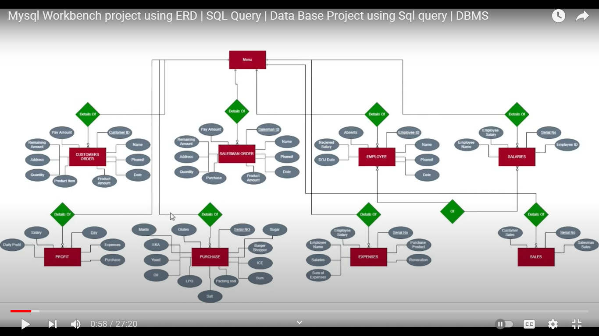
Entity-Relation Diagram

Slide 4

ENTITIES AND ATTRIBUTES

Slide 5



Sale_Man:
Attributes:
ID (Primary Key): Unique identifier for each sales transaction
Name: Name of the salesperson.
Address: Address of the salesperson.
Purchase_Items: Items sold by the salesperson.
Quantity: Quantity of items sold.
Phone_No: Contact number of the salesperson.
Sum: Total sum of the transaction.
Pay_Amount: Amount paid by the customer.
Date: Date of the transaction.
Remaining_Amount: Remaining amount to be paid by the customer.
Expenses:
Attributes:
Serial_No (Primary Key): Unique identifier for each expense record.
Purchase_Product, Renovation, Salaries: Expenses incurred in various categories.
Sum_of_Expenses: Total sum of expenses.
Date: Date when the expenses were incurred.
Profit:
Attributes:
Day (Primary Key): Unique identifier for each day's profit.
Expenses, Purchase, Salary: Components of daily expenses.
Daily_profit: Total profit earned on that day.
Menu:
Attributes:
Serial_No (Primary Key): Unique identifier for each menu item.
Salesman_Name: Name of the salesperson.
Employee_Name: Name of the employee.
Customer_Name: Name of the customer.
Profit: Profit earned from the transaction.
Product: Total product sales amount.
Salaries: Salary amount associated with the transaction
Sales:
Attributes:
Serial_No (Primary Key): Unique identifier for each sales record.
Sale_Man_Sales: Sales made to salesmen.
Customer_Sales: Sales made to customers.

Slide 6
Employee:
Attributes:
ID (Primary Key): Unique identifier for each employee.
Name: Name of the employee.
Address: Residential address of the employee.
Designation: Job title or position held by the employee.
Salary: Monthly salary of the employee.
DOJ (Date of Joining): Date when the employee joined the company.
Absences: Number of days the employee has been absent.
Received_Salary: Amount of salary received by the employee.
Purchase:
Attributes:
Serial_No (Primary Key): Unique identifier for each purchase.
Salt, Sugar, Flour, Oil, Yeast: Quantities of respective items purchased.
Packing_reel, Cartoon_Box, Packing_Shopper: Quantities of packing materials purchased.
Sum: Total sum of all items purchased in the transaction.
Customer:
Attributes:
ID (Primary Key): Unique identifier for each customer.
Name: Name of the customer.
Address: Address of the customer.
Purchase_Items: Items purchased by the customer.
Quantity: Quantity of items purchased.
Phone_No: Contact number of the customer.
Product_Amount: Total amount of purchased products.
Pay_Amount: Amount paid by the customer.
Date: Date of the purchase.
Remaining_Amount: Remaining amount to be paid by the customer.
Salaries:
Attributes:
Serial_No (Primary Key): Unique identifier for each salary record.
Employee_ID (Foreign Key): Links to the ID of the corresponding employee.Employee_Name: Name of the employee.
Employee_Salary: Salary amount for the employee.

Slide 7

Database Schema
Employee:
Stores information about employees such as their name, address, designation, salary, date of joining, absences, and received salary.
Customer: Manages customer data including their name, address, purchased items, quantity, phone number, purchase amount, payment amount, date, and remaining amount.
Purchase: Keeps track of purchases made by the factory including details of items purchased such as salt, sugar, flour, oil, yeast, packing materials, and the total sum.
Sale_Man: Records sales made by salesmen, including details such as name, address, items sold, quantity, phone number, total amount, payment amount, date, and remaining amount.
Salaries: Stores information about employee salaries including their ID, name, and salary amount.
Expenses: Tracks various expenses incurred by the factory including purchase of products, renovation costs, salary expenses, total expenses, and date.
Sales: Records sales made by the factory, distinguishing between sales to salesmen and customers.
Profit: Calculates daily profits based on expenses, purchases, salaries, and total profit.
Menu: Provides a summary of sales, employee, and customer data along with profit, product, and salary information.

Slide 8
CRUD Operations
1. Create
The CREATE operation adds new records to a table. Here's how you can add a new employee to the Employee table:
INSERT INTO Employee (Name, Address, Designation, Salary, DOJ, Absences, Received_Salary)
VALUES
('John Doe', 'Example Address', 'Engineer', 50000.00, '2024-06-01', 0, 50000.00);

Slide 9
2. Read
The READ operation retrieves data from a table. Here are some examples of how to read data from the Employee table:
Retrieve all employees:
SELECT * FROM Employee;
Retrieve specific columns:
SELECT Name, Designation FROM Employee;
Retrieve data with a condition:
SELECT * FROM Employee WHERE Designation = 'Manager';

Slide 10
3. Update
The UPDATE operation modifies existing records in a table. Here’s how you can update an employee’s salary in the Employee table:
UPDATE Employee
SET Salary = 65000.00
WHERE ID = 1;

Slide 11
4. Delete
The DELETE operation removes records from a table. Here’s how you can delete an employee from the Employee table:
DELETE FROM Employee
WHERE ID = 2;

Slide 12



Primary Key:
A primary key uniquely identifies each record in a table. It ensures that each record is unique and serves as a reference point for other tables' foreign keys.
Foreign Key:
A foreign key establishes a relationship between two tables. It links a column in one table to the primary key column of another table, facilitating data integrity and enforcing referential integrity constraints.

Slide 13
Conclusion
in conclusion, our Factory Store Management System database project represents a significant step forward in revolutionizing how factories manage their store operations. By centralizing data, automating processes, and providing insightful analytics, our system empowers factory managers to navigate the complexities of store management with ease and confidence.
Through this project, we envision a future where factories can operate more efficiently, reduce costs, minimize waste, and ultimately drive greater profitability. As technology continues to evolve, we remain committed to refining and enhancing our database project to meet the evolving needs of the industrial landscape.

